Slide 1

Documentation du code source
025947 - Documentation logicielle, bonnes pratiques en programmation
Steve Fotso
025914 - Assurance de qualité logicielle

Slide 2
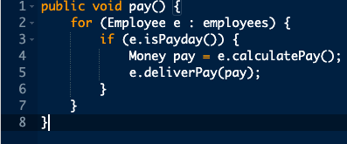
Projet Individuel
La fonction ci dessous accomplie plus d’une action, modifiez la en utilisant les règles discutées dans cette présentation

Slide 3
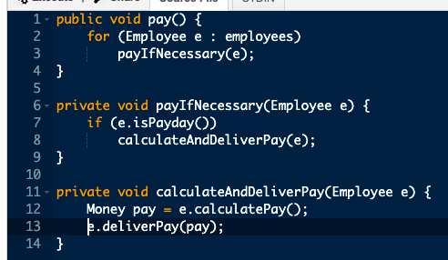
Projet Individuel - Solution

Slide 4
Les commentaires n’améliorent pas un mauvais code
Les langages de programmation ne sont pas assez expressifs
Les commentaires doivent donc être utilisés quand on ne peut pas s’exprimer dans le code.
Attention, les commentaires peuvent être menteurs
Plus le code est mieux, plus il y’a des chances que le commentaire est menteur.
Beaucoup de programmeurs commentent car leur code est mauvais
Il est préférable d’utiliser ce temps pour nettoyer le code.
Notes:
The consequences of these can prove to be extremely frustrating and expensive:
The general perception of the quality of the output begins to deteriorate as the team spends more and more time in fixing bugs than in actually creating new features
In extreme cases, adding features becomes virtually impossible with seemingly unrelated parts of the system failing due to the addition of a feature or, worse – fixing an earlier bug
Costs of adding features increases at an alarming rate with each delivery cycle
Adding more people becomes difficult, as they take a long time to come up to speed; sometimes, new team members are blatantly scared to touch large parts of the code, due to the fear of failure
Customer complaints increase, putting intense pressure to write an even worse code – to keep fixing the issues quickly

Slide 5
Expliquez vous dans le code
On a généralement tendance à vouloir s’exliquer avec des commentaires, mais il est préférable de faire cela à travers le code
// Check to see if the employee is eligible for full benefits
if ( (employee.flags & HOURLY_FLAG) && (employee.age > 65)
if (employee.isEligibleForFullBenefits())
Notes:
The consequences of these can prove to be extremely frustrating and expensive:
The general perception of the quality of the output begins to deteriorate as the team spends more and more time in fixing bugs than in actually creating new features
In extreme cases, adding features becomes virtually impossible with seemingly unrelated parts of the system failing due to the addition of a feature or, worse – fixing an earlier bug
Costs of adding features increases at an alarming rate with each delivery cycle
Adding more people becomes difficult, as they take a long time to come up to speed; sometimes, new team members are blatantly scared to touch large parts of the code, due to the fear of failure
Customer complaints increase, putting intense pressure to write an even worse code – to keep fixing the issues quickly

Slide 6
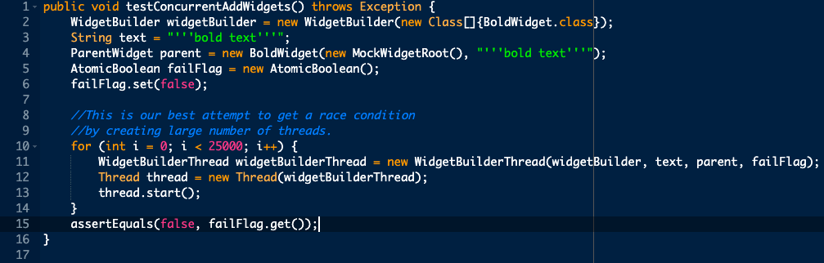
Les bons commentaires
Commentaire sur la partie légale
Commentaire qui donne de l’information
Commentaire qui explique l’intention
Notes:
The consequences of these can prove to be extremely frustrating and expensive:
The general perception of the quality of the output begins to deteriorate as the team spends more and more time in fixing bugs than in actually creating new features
In extreme cases, adding features becomes virtually impossible with seemingly unrelated parts of the system failing due to the addition of a feature or, worse – fixing an earlier bug
Costs of adding features increases at an alarming rate with each delivery cycle
Adding more people becomes difficult, as they take a long time to come up to speed; sometimes, new team members are blatantly scared to touch large parts of the code, due to the fear of failure
Customer complaints increase, putting intense pressure to write an even worse code – to keep fixing the issues quickly

Slide 7
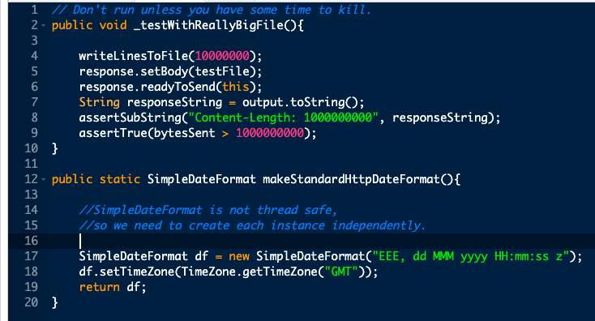
Les bons commentaires (suite)
Commentaire qui met en garde
Notes:
The consequences of these can prove to be extremely frustrating and expensive:
The general perception of the quality of the output begins to deteriorate as the team spends more and more time in fixing bugs than in actually creating new features
In extreme cases, adding features becomes virtually impossible with seemingly unrelated parts of the system failing due to the addition of a feature or, worse – fixing an earlier bug
Costs of adding features increases at an alarming rate with each delivery cycle
Adding more people becomes difficult, as they take a long time to come up to speed; sometimes, new team members are blatantly scared to touch large parts of the code, due to the fear of failure
Customer complaints increase, putting intense pressure to write an even worse code – to keep fixing the issues quickly

Slide 8
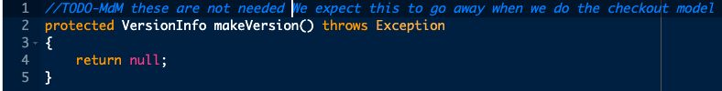
Les bons commentaires (suite)
Les commentaire TODO (À faire)
Notes:
The consequences of these can prove to be extremely frustrating and expensive:
The general perception of the quality of the output begins to deteriorate as the team spends more and more time in fixing bugs than in actually creating new features
In extreme cases, adding features becomes virtually impossible with seemingly unrelated parts of the system failing due to the addition of a feature or, worse – fixing an earlier bug
Costs of adding features increases at an alarming rate with each delivery cycle
Adding more people becomes difficult, as they take a long time to come up to speed; sometimes, new team members are blatantly scared to touch large parts of the code, due to the fear of failure
Customer complaints increase, putting intense pressure to write an even worse code – to keep fixing the issues quickly

Slide 9
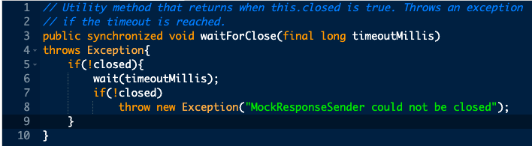
Les mauvais commentaires
Les commentaires Redundant et de bruits
Notes:
The consequences of these can prove to be extremely frustrating and expensive:
The general perception of the quality of the output begins to deteriorate as the team spends more and more time in fixing bugs than in actually creating new features
In extreme cases, adding features becomes virtually impossible with seemingly unrelated parts of the system failing due to the addition of a feature or, worse – fixing an earlier bug
Costs of adding features increases at an alarming rate with each delivery cycle
Adding more people becomes difficult, as they take a long time to come up to speed; sometimes, new team members are blatantly scared to touch large parts of the code, due to the fear of failure
Customer complaints increase, putting intense pressure to write an even worse code – to keep fixing the issues quickly

Slide 10

Les mauvais commentaires (suite)
Les commentaires menteur – retour au code précédent, le commentaire est aussi menteur, pourquoi ?
Les commentaires à la fermeture des crochets.
Code non utilisé et laissé en commentaire.
Ne pas utiliser de commentaire si on peut utiliser une variable ou une fonction à la place.
Notes:
The consequences of these can prove to be extremely frustrating and expensive:
The general perception of the quality of the output begins to deteriorate as the team spends more and more time in fixing bugs than in actually creating new features
In extreme cases, adding features becomes virtually impossible with seemingly unrelated parts of the system failing due to the addition of a feature or, worse – fixing an earlier bug
Costs of adding features increases at an alarming rate with each delivery cycle
Adding more people becomes difficult, as they take a long time to come up to speed; sometimes, new team members are blatantly scared to touch large parts of the code, due to the fear of failure
Customer complaints increase, putting intense pressure to write an even worse code – to keep fixing the issues quickly

Slide 11

Les mauvais commentaires (suite)
Notes:
The consequences of these can prove to be extremely frustrating and expensive:
The general perception of the quality of the output begins to deteriorate as the team spends more and more time in fixing bugs than in actually creating new features
In extreme cases, adding features becomes virtually impossible with seemingly unrelated parts of the system failing due to the addition of a feature or, worse – fixing an earlier bug
Costs of adding features increases at an alarming rate with each delivery cycle
Adding more people becomes difficult, as they take a long time to come up to speed; sometimes, new team members are blatantly scared to touch large parts of the code, due to the fear of failure
Customer complaints increase, putting intense pressure to write an even worse code – to keep fixing the issues quickly

Slide 12
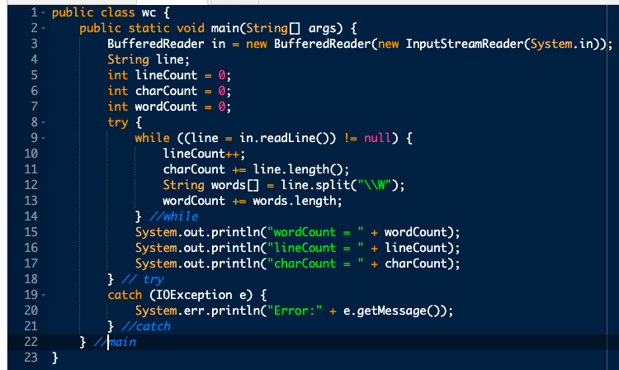
Les mauvais commentaires (suite)
Notes:
The consequences of these can prove to be extremely frustrating and expensive:
The general perception of the quality of the output begins to deteriorate as the team spends more and more time in fixing bugs than in actually creating new features
In extreme cases, adding features becomes virtually impossible with seemingly unrelated parts of the system failing due to the addition of a feature or, worse – fixing an earlier bug
Costs of adding features increases at an alarming rate with each delivery cycle
Adding more people becomes difficult, as they take a long time to come up to speed; sometimes, new team members are blatantly scared to touch large parts of the code, due to the fear of failure
Customer complaints increase, putting intense pressure to write an even worse code – to keep fixing the issues quickly

